Slide 1

Customer Churn Prediction for Telecom Using Machine Learning
Presented by: Bitan Ghosh
Section: BCS-3B
Department: Computer Science and Engineering
University: Techno India University

Slide 2

Introduction: Understanding Customer Churn in Telecom
Customer churn refers to the phenomenon where subscribers discontinue their service with a telecom provider. In a competitive market, predicting and preventing churn is critical for business sustainability and growth.
Why Churn Prediction?
Machine Learning's Role
Proactive identification of at-risk customers allows companies to implement targeted retention strategies, significantly reducing customer loss and protecting revenue streams.
Machine learning models analyze vast datasets to identify patterns and predict future churn behavior, offering powerful insights beyond traditional methods.
This project leverages real telecom customer data to build a robust churn prediction system.

Slide 3
Project Objectives: Building a Robust Prediction Model
Our primary goal is to develop an accurate and actionable machine learning model for customer churn prediction in the telecom sector.
01
02
03
Predictive Model Development
Data Preprocessing
Class Imbalance Handling
Construct a machine learning model capable of identifying customers with a high likelihood of churning.
Clean and prepare raw telecom data, addressing missing values, encoding categorical features, and scaling numerical data.
Utilize techniques like SMOTE to mitigate the impact of imbalanced churn classes, ensuring fair model training.
04
05
06
Model Training & Evaluation
Improve Customer Satisfaction
Reduce Overall Churn Rate
Train and compare multiple ML algorithms (Decision Tree, Random Forest, XGBoost) and select the best-performing model.
Provide insights that enable proactive interventions to address customer concerns and improve overall service experience.
Leverage predictions to implement targeted retention campaigns, thereby lowering the churn rate and increasing customer lifetime value.
07
08
Enhance Data-Driven Decision-Making
System Implementation
Equip stakeholders with actionable intelligence to make informed decisions regarding marketing, product development, and customer service strategies.
Develop a simple input-based prediction system that uses the trained model for practical application.

Slide 4
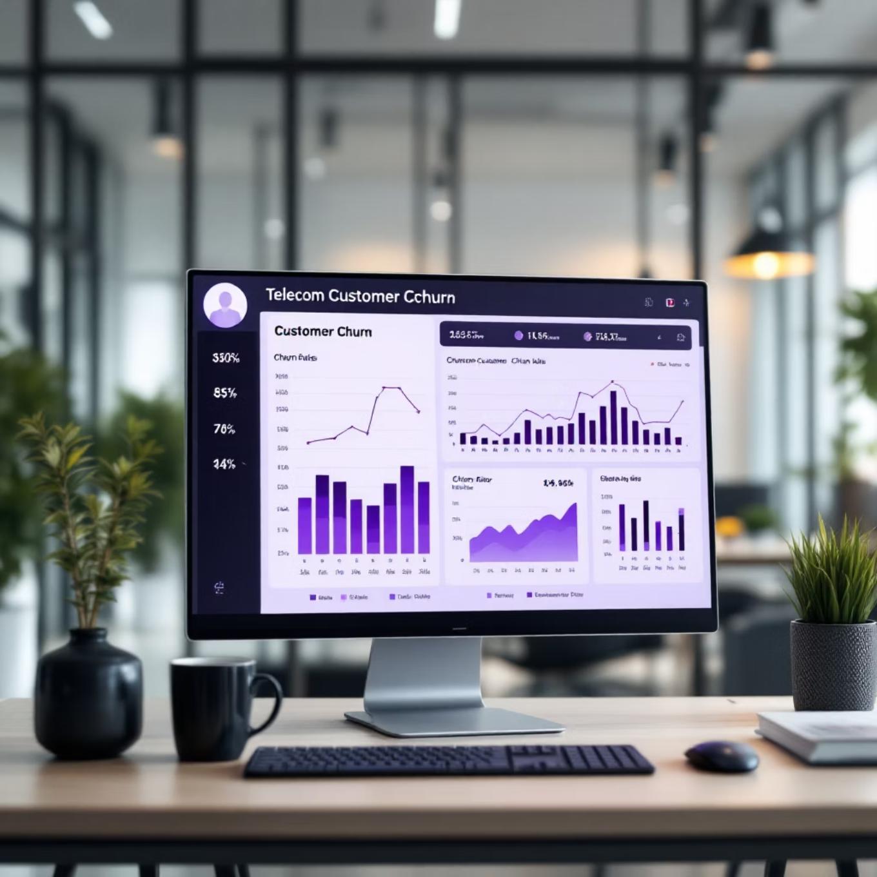
Dataset Overview: Telco Customer Churn
The project utilizes the "Telco Customer Churn" dataset from Kaggle, a comprehensive collection of customer information.
Dataset Size
Data Types
Comprises 7,043 rows and 21-22 columns, detailing various aspects of telecom customer behavior and demographics.
Includes both categorical (e.g., gender, contract type, internet service, payment method) and numerical features (e.g., tenure, monthly charges, total charges).
Key Data Handling Steps:
Missing values in TotalCharges were identified and replaced with 0.
The customerID column was dropped as it holds no predictive power.
Initial analysis revealed a significant churn imbalance, necessitating specific handling.

Slide 5
Dataset Numerical Statistics
A closer look at the "Telco Customer Churn" dataset's structural characteristics.
Dataset Size
Feature Breakdown
Total Customers: 7,043
Numerical Columns: 3 (tenure, MonthlyCharges, TotalCharges)
Total Features: 21 (after dropping customerID)
Categorical Columns: 18
Average Tenure
Median Monthly Charges
Contract Type Distribution
Customers stay with the company for an average of 32 months, indicating a moderate customer lifecycle.
The median monthly charge is $70.35, providing insight into typical customer expenditure.
Month-to-month: ~55%
One year: ~21%
Two year: ~24%
The prevalence of month-to-month contracts suggests higher churn risk.

Slide 6

Technologies Used: Tools for Prediction
A suite of powerful tools and libraries were employed to facilitate data processing, model training, and evaluation.
Python
Pandas & NumPy
The primary programming language for all development.
Essential for efficient data manipulation and numerical operations.
Matplotlib & Seaborn
scikit-learn
Used for exploratory data analysis (EDA) and visualization.
A robust library for machine learning modeling and evaluation.
SMOTE
XGBoost
Synthetic Minority Over-sampling Technique, crucial for addressing class imbalance.
A powerful gradient boosting framework used for model training.
Pickle
Google Colab
For serializing and deserializing Python objects, used to save models.
The cloud-based environment used for development and execution.

Slide 7

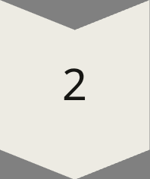
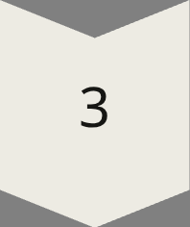
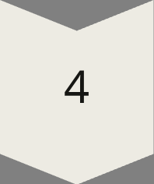
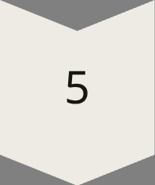

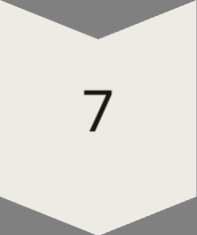
Model Implementation: From Data to Prediction
The machine learning pipeline involves a series of structured steps to ensure data quality and optimal model performance.
1. Data Processing
Loading raw data, followed by cleaning to handle inconsistencies.
2. Feature Engineering
Encoding categorical features using LabelEncoder for model compatibility.
3. Data Splitting
Dividing the dataset into training and testing sets.
4. Balancing Data
Applying SMOTE oversampling to address class imbalance in the training data.
5. Model Training
Training Decision Tree, Random Forest, and XGBoost models.
6. Evaluation & Selection
Cross-validation to compare model accuracy, leading to Random Forest selection.
7. Model Persistence
Saving the selected model and encoders using Pickle for future use.

Slide 8
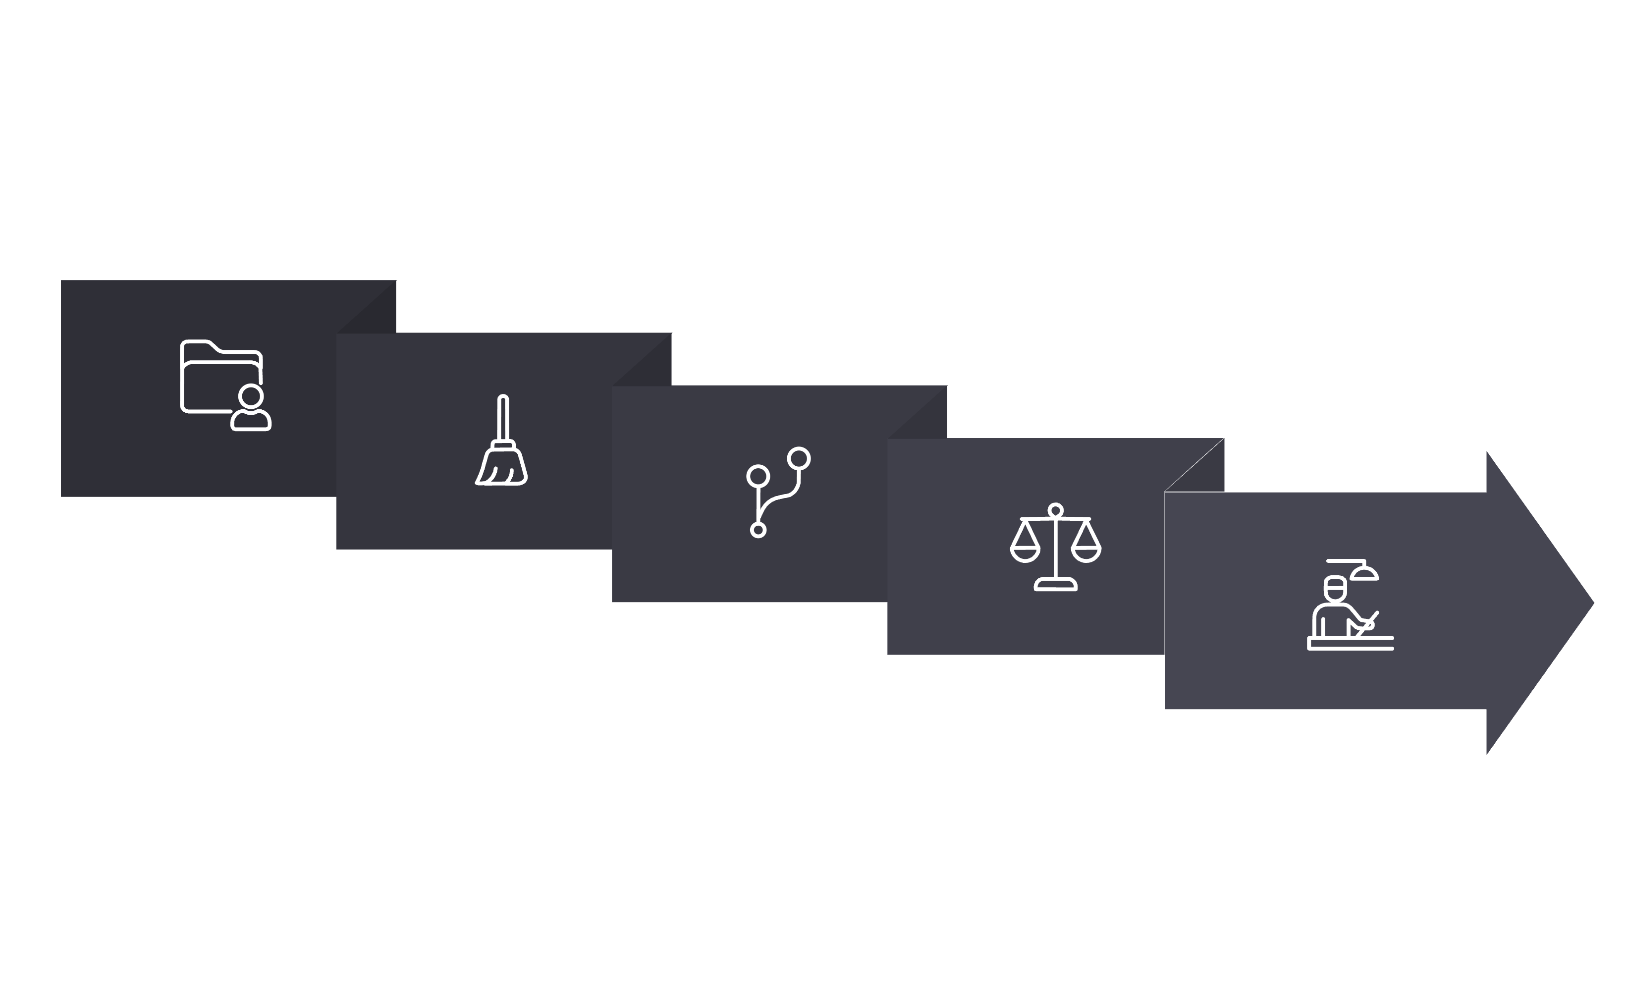
System Architecture: Flow of Prediction
The prediction system follows a clear, sequential architecture to process customer information and deliver churn insights.
Data Input
Encoding
Raw customer data is fed into the system for initial processing.
Categorical features are converted into numerical representations for ML model compatibility.
Model Training
Selected ML models (Decision Tree, Random Forest, XGBoost) are trained to learn churn patterns.
Data Cleaning
Missing values and inconsistencies are handled to ensure data quality and integrity.
SMOTE
SMOTE is applied to balance the dataset, preventing bias towards the majority class.

Slide 9

Challenges & Solutions: Overcoming Hurdles
During the project, several common machine learning challenges were encountered and effectively addressed.
Missing Values in TotalCharges
Solution: Blanks were replaced with 0 and the column was converted to a float data type.
Imbalanced Churn Classes
Solution: Applied SMOTE oversampling technique to balance the dataset, preventing biased predictions.
Numerous Categorical Features
Solution: Implemented Label Encoding for each categorical feature and stored encoders in a dictionary for consistency.
Need for User-Friendly Prediction
Solution: Developed an input-driven system leveraging the saved model and encoders for real-time predictions.

Slide 10


Results & Conclusion: Empowering Churn Prevention
The project successfully developed a robust machine learning model, primarily using Random Forest, that excels in predicting customer churn. This high level of accuracy ensures reliable identification of customers likely to discontinue service, providing a critical tool for business intelligence.
80%
75%
Random Forest Accuracy
Precision & Recall
The Random Forest model achieved an impressive 80% cross-validation accuracy, outperforming other algorithms tested. This strong predictive capability is crucial for making informed business decisions regarding customer retention.
With a 75% precision and recall rate on unseen test data, the model effectively minimizes false positives and false negatives. This ensures both efficiency in targeting at-risk customers and comprehensive coverage of those likely to churn.
By providing a quantifiable churn probability for each telecom customer, this model delivers actionable insights, allowing businesses to understand 'who' is likely to churn and 'why' based on underlying feature importance.
Strategic Impact:
Significantly reduces customer attrition by pinpointing high-risk individuals before they leave, enabling targeted intervention strategies.
Empowers marketing and customer service teams to design and deploy highly effective, personalized retention campaigns, optimizing resource allocation and maximizing return on investment.
Provides data-driven intelligence for long-term strategic planning, helping to refine service offerings and improve overall customer satisfaction.

